Slide 1


FIRST LEGO League:
Share & Learn
Beginner Workshop

Slide 2
Introductions

Slide 3

Three PARTS OF FIRST LEGO LEAGUE
Robot Game: Design & program a MINDSTORMS robot to autonomously complete missions in 2.5 mins on a themed course
Core Values: Demonstrate teamwork and cooperation
Research Project: Develop an innovative solution for a real-world problem
Spend time on all three parts

Slide 4
COMPETITION HIERARCHY IN YOUR STATE
Customize this slide
April-June
REGIONAL or
QUALIFIER
STATE CHAMPIONSHIP
WORLD FESTIVAL and INTERNATIONAL OPENs
December-January
November-December
March-June
GLOBAL INNOVATION AWARD

Slide 5
AWARDS
Customize this slide
Robot Performance: Highest robot performance scores
Robot Game: Robot Design, Programming, Strategy & Innovation
Champion’s Award
Best all-rounded team
Must make 40% cut-off in Robot Performance
Research Project: Research, Innovative Solution, Presentation
Core Values: Inspiration, Teamwork, Gracious Professionalism
Different tournaments give a different number awards based on the region as well as how large the tournament is.
Please check with your region.

Slide 6
SIX HIGH LEVEL TIPS
1) Read the challenge documents carefully (videos of missions/rules do not count). Read an updates posted during the season.
2) Refer to the rubrics provided by FIRST often. The rubrics will help a team know what they need to do in each category
3) Develop your own team style. Set your own goals.
4) Make mistakes – Learn – Revise. It’s all part of the process.
5) Make sure everyone on the team is involved and has an understanding of other sections even if they were not the lead on it
6) Don’t hesitate to ask for help. The FIRST community is very supportive.

Slide 7
CORE VALUES

Slide 8
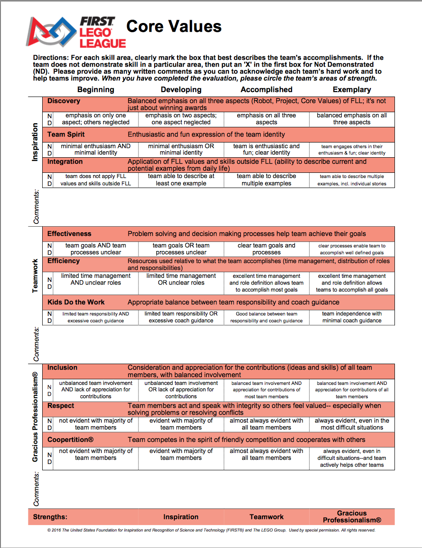
CORE VALUES RUBRIC
Discovery: Spend equal time on all three parts of FLL
Team Spirit: What’s your team identity
Integration: Use what you learn outside of FIRST
Effectiveness: How well do you plan the task?
Efficiency: How much do you get done?
Kids Do the Work: Is there too much adult involvement?
Inclusion: Include all team members
Respect: Respect teammates
Coopertition: Respect other teams. Practice good sportsmanship.

Slide 9
CORE VALUES POSTER
Used to guide discussion in Core Values judging
Optional in some regions (check with your organizers)
Customize this slide

Slide 10
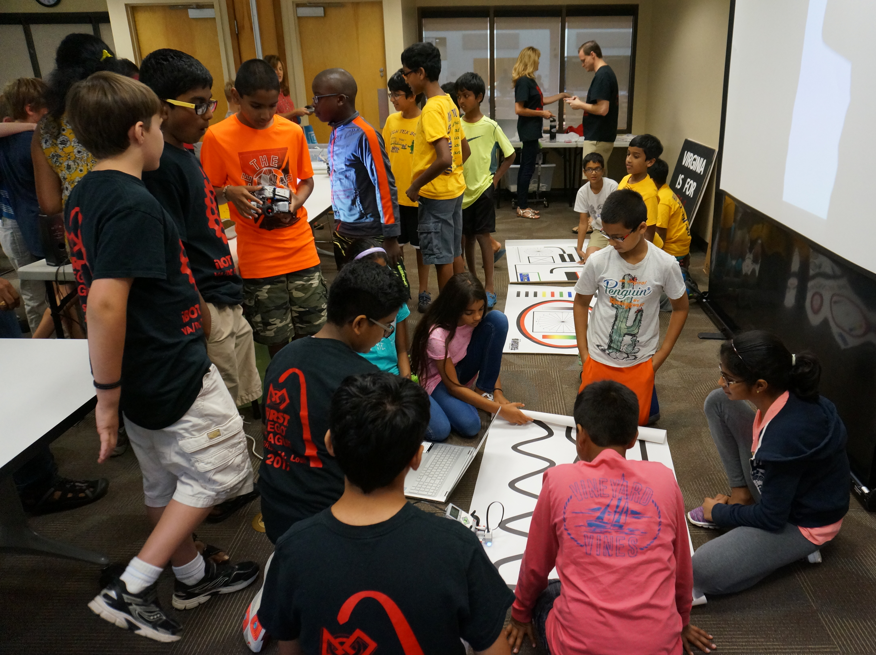
SHARING OUR EXPERIENCES: OUTREACH ACTIVITIES
Goal is to spread FIRST and STEM
Example Outreach Events:
Public Library
School
Museum
Mall
Mini Maker Faire
Barnes & Noble
State Fair

Slide 11
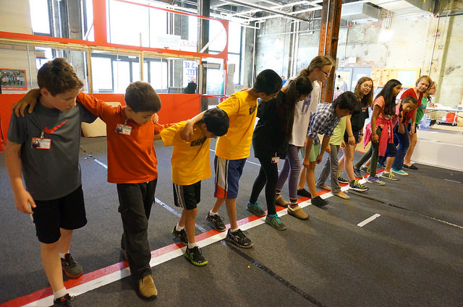
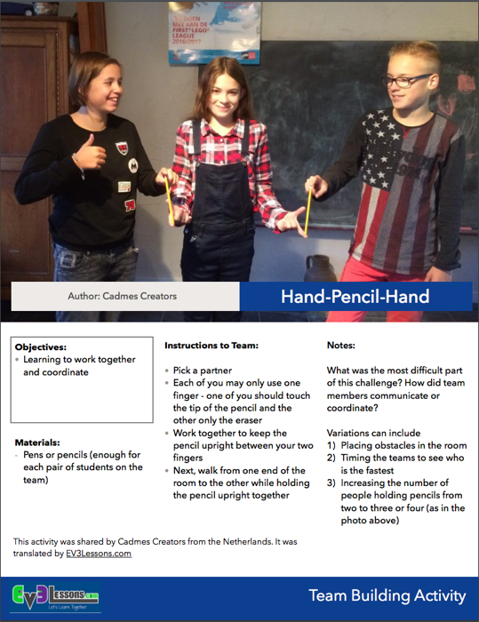
IMPROVING TEAMWORK
Doing Core Value Activities within your team or with other teams can help you become a better team
Team we coached improved teamwork skills through the activities we gave them
Where can you get sample team building activities activities?
EV3Lessons.com (Resources) has activities to try

Slide 12
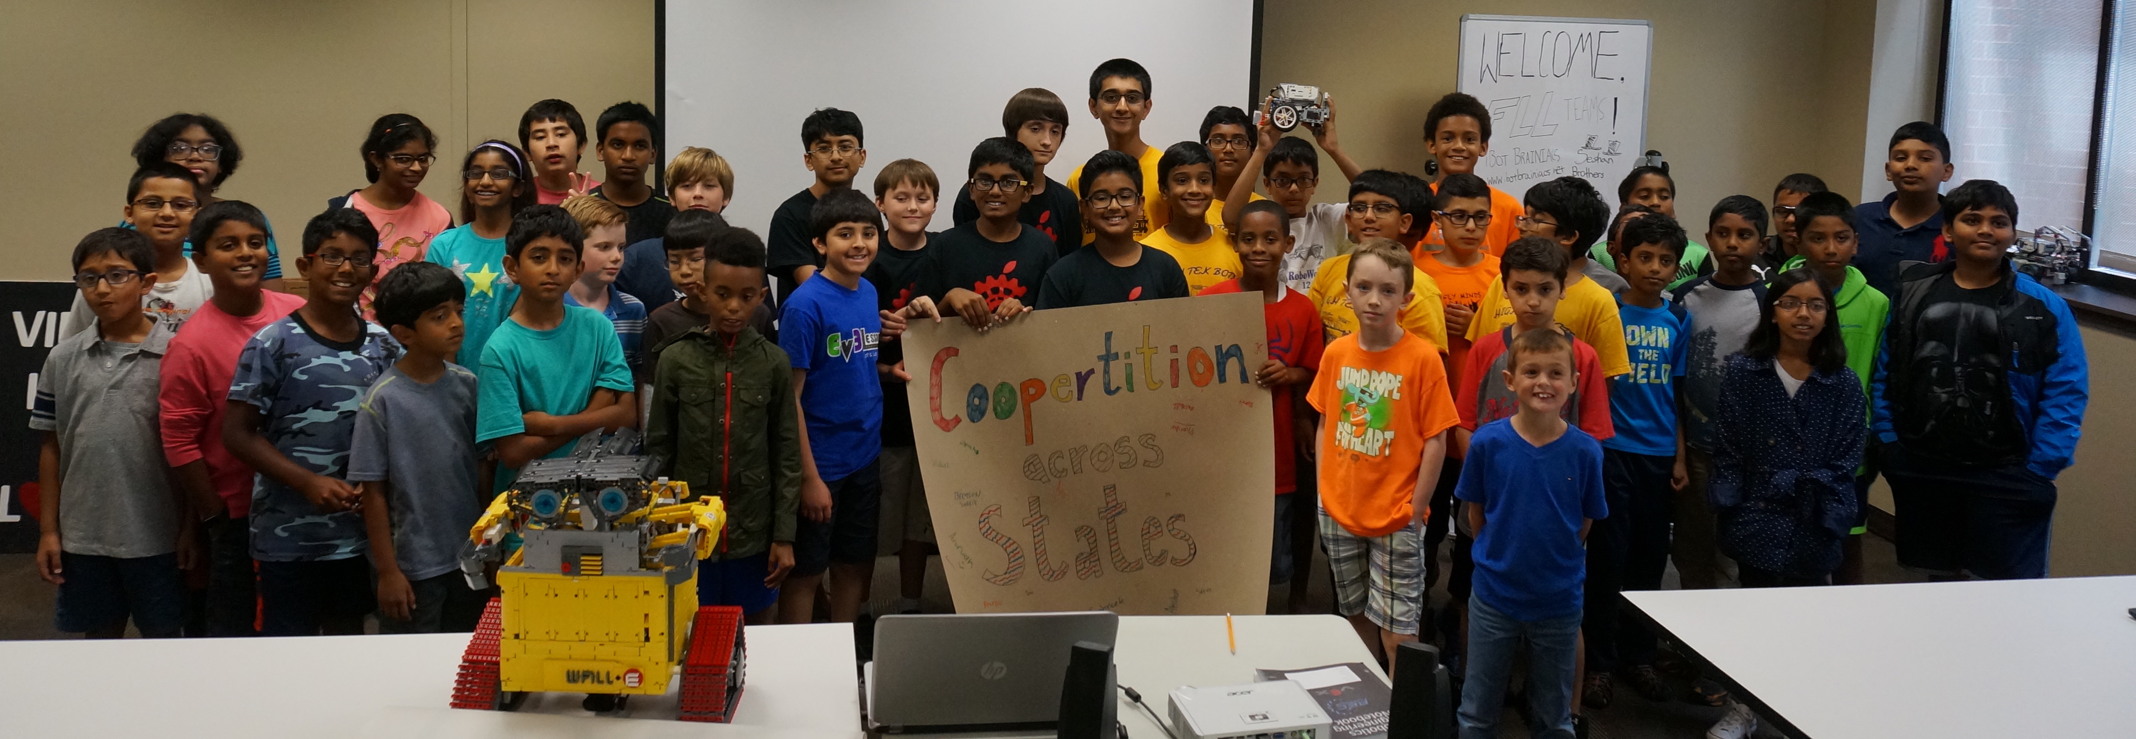
GRACIOUS PROFESSIONALISM & COOPERTITION
Supporting other teams at events
Helping them at events (sharing parts)
Presenting projects to another team to get feedback

Slide 13
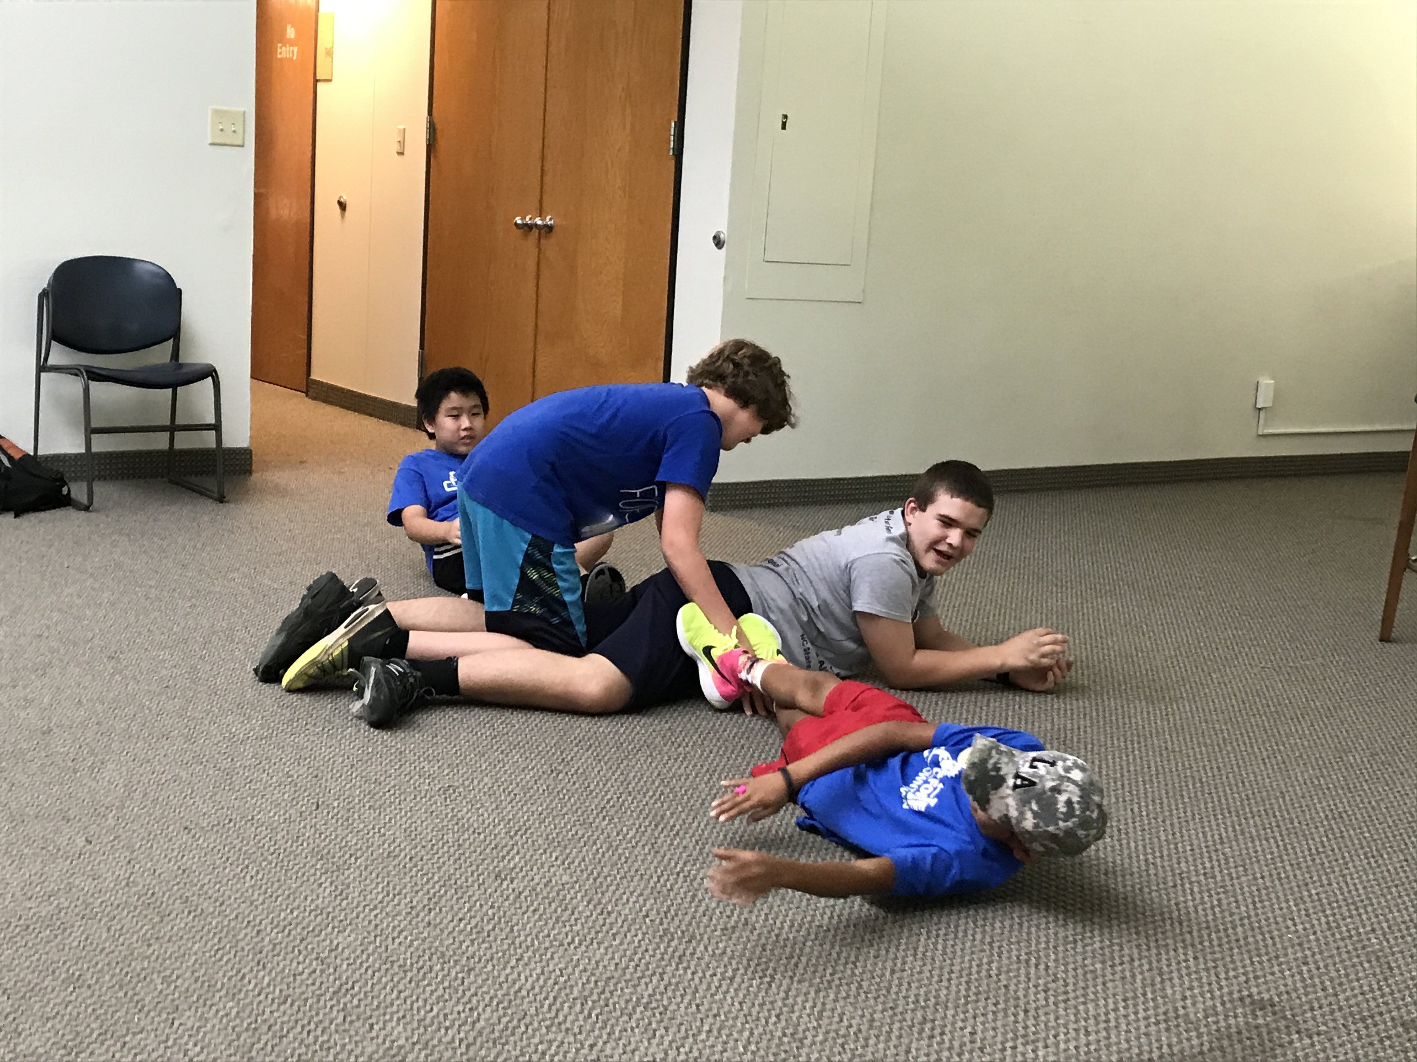
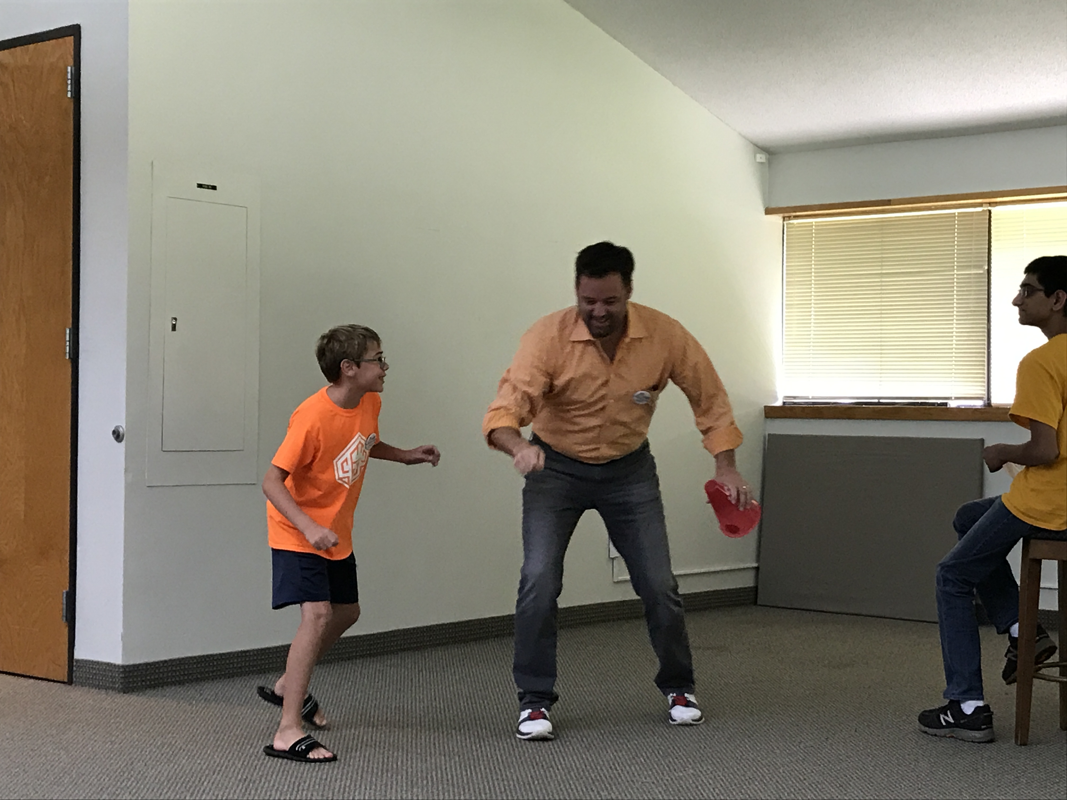
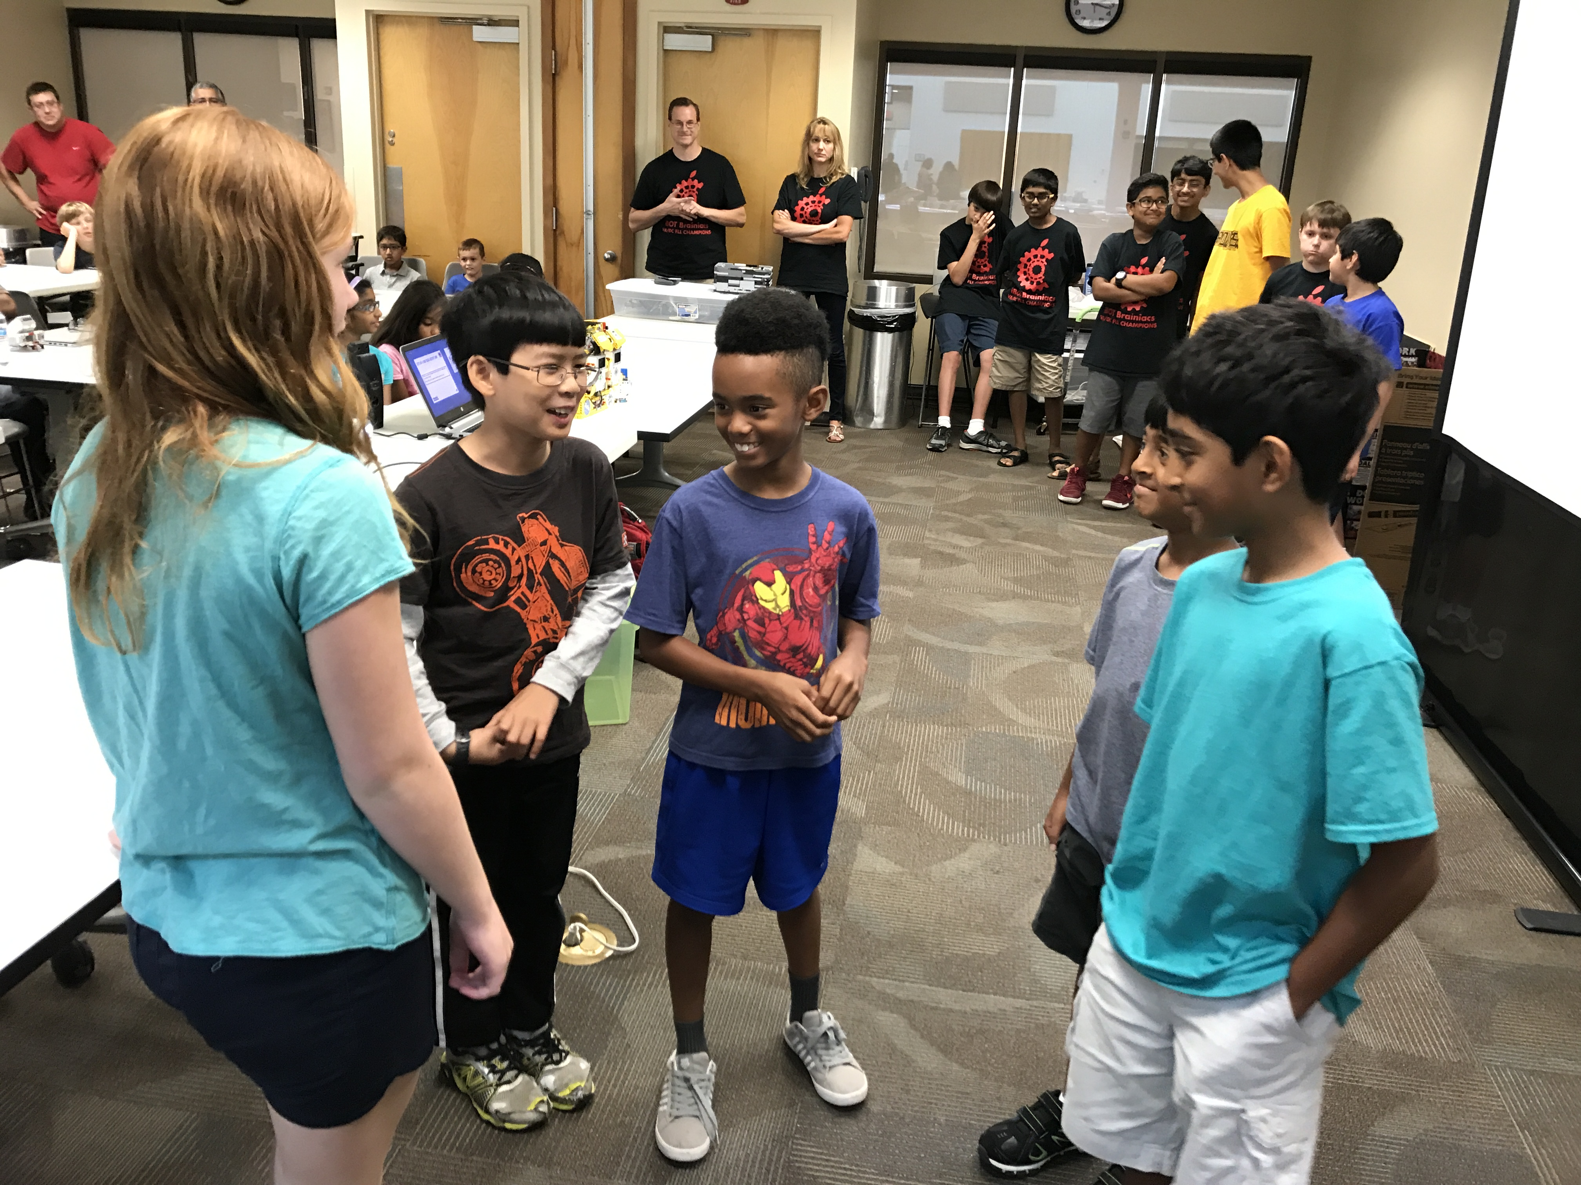
NOW LET’S DO A CORE VALUES ACTIVITY NOW
Have each team attending do an activity
Customize this slide

Slide 14
Research PROJECT

Slide 15

What is the Research Project?
A group research project related to the year’s theme
Come up with an innovative solution to a real-world problem
Themes:
2011: Food Factor (food safety)
2012: Senior Solutions (senior citizens)
2013: Nature’s Fury (natural disasters)
2014: World Class (education)
2015: Trash Trek (garbage)
2016: Animal Allies (animals)
2017: Hydro Dynamics (water)

Slide 16
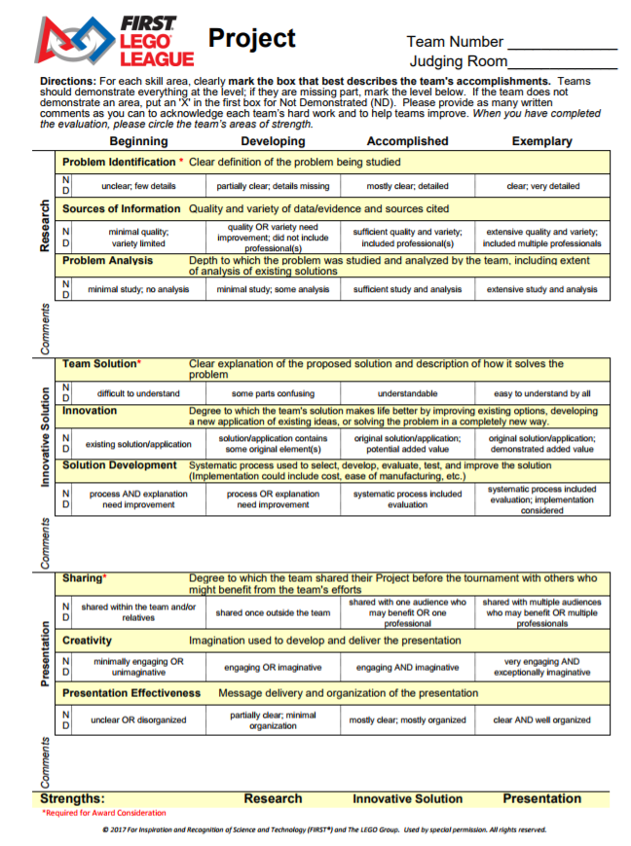

Project Rubric
Research
Identify a problem and analyze existing solutions
Innovative Solution
Develop a solution to your problem and understand what it would take to implement this idea.
Presentation
Share your project with people/organizations
Create an effective presentation for judges
Note: New Rubric for 2017

Slide 17
Project Process: TIPS
Pick Problem
Background Research
Innovative Solution
Test Solution
Sharing/
Presentation
Research
Innovative Solution
Sharing
Always follow challenge guidelines.
Sometimes there are specific rules. (Must have a senior partner)
Take time to understand what solutions already exist.
Think about how your team solve the problem?
How can you implement the idea?
Doesn’t have to be 100% novel. Can be an improvement.
Test the idea or create a simple prototype of some kind (out of LEGO, cardboard)
Share your solution with someone who will benefit
Create a presentation for the judges.

Slide 18
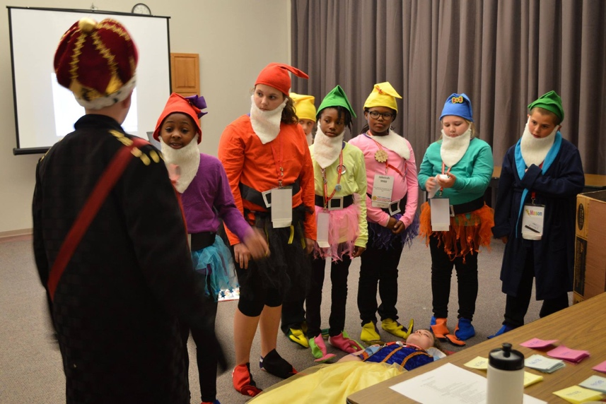
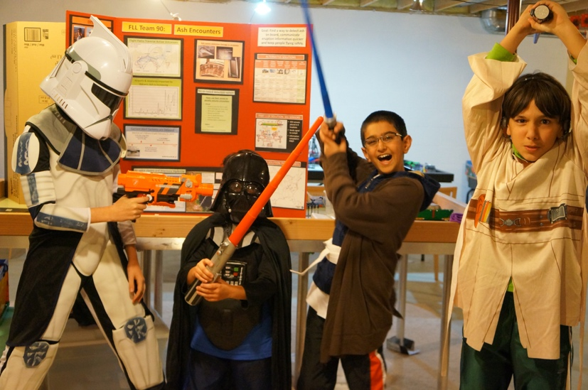
Types of presentations
No one way to present
Game Show
Example: Shark Tank
Movie/Cartoon Theme
Example: Snow White
Informative Lecture
Magic Show
Connected to your team name
Example: Star Wars
Photo Credit: Razorback Open, 2015

Slide 19
SAMPLE PROJECTS
2011: Food Factor (food safety)
Detecting spoilt milk
2012: Senior Solutions (senior citizens)
Helping seniors remember where they left their processions
2013: Nature’s Fury (natural disasters)
An early-warning ash detection system for airplanes
2014: World Class (education)
A better way to learn to program the EV3 (EV3Lessons.com)
2015: Trash Trek (garbage)
A more efficient way to recycle batteries (InvisiSort)
2016: Animal Allies (animals)
Bats getting killed by wind turbines

Slide 20
Watch a sample presentation video NOW
There are many project videos available on YouTube.
Encore Performances from World Festival are available online.
Customize this slide

Slide 21
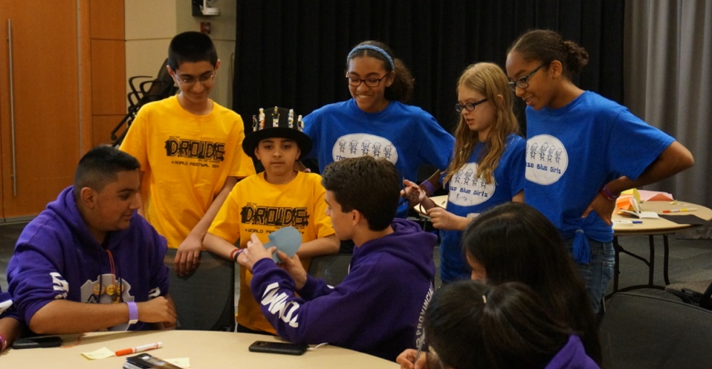
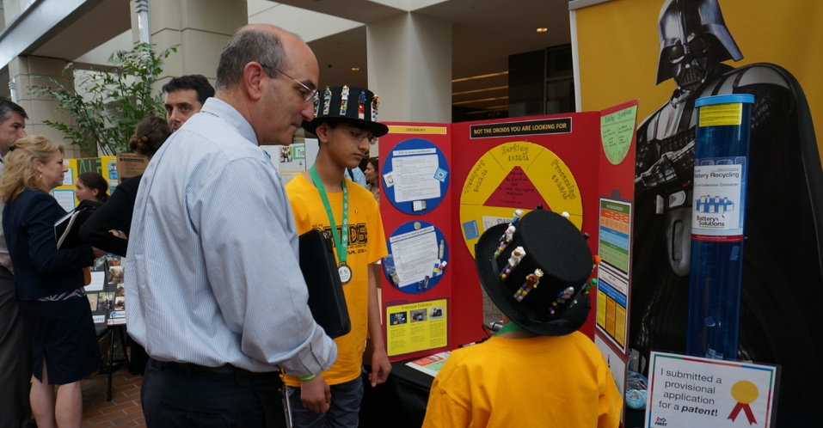
GLOBAL INNOVATION AWARD
Customize this slide
Nominated by local tournament (usually the highest scoring team in Innovative Solution, but can vary in some regions)
Fill in online application in March
Top 20 invited to D.C
Present to a panel of judges
Attend workshops on patents and innovation

Slide 22
ROBOT GAME

Slide 23
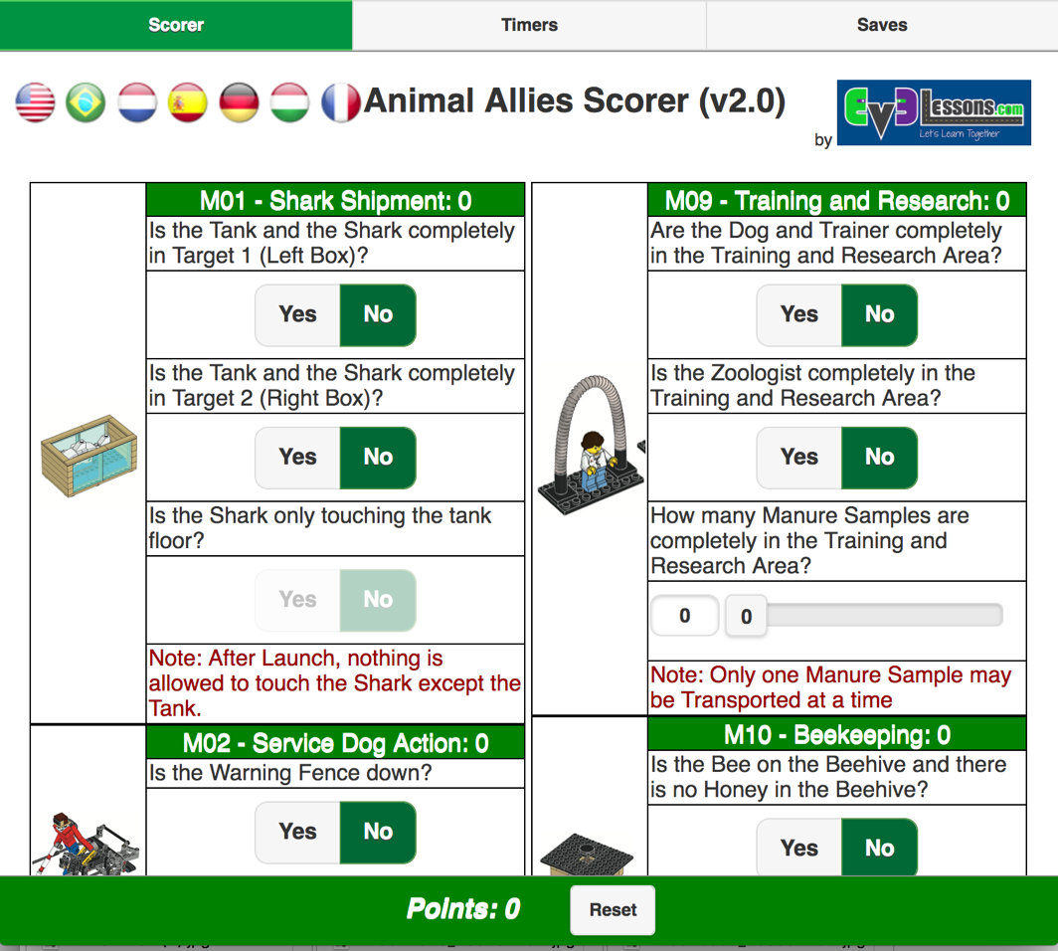
IMPORTANT ASPECTS OF THE GAME
Sample Scorer
Rules changes in recent years and get familiar with some of these terms
Height
Junk
Sprawl
Touch Penalties
Base rules about in/out
Partially in versus fully in
Scoring
Track your own score during the season
http://ev3lessons.com/resources/scorer/

Slide 24
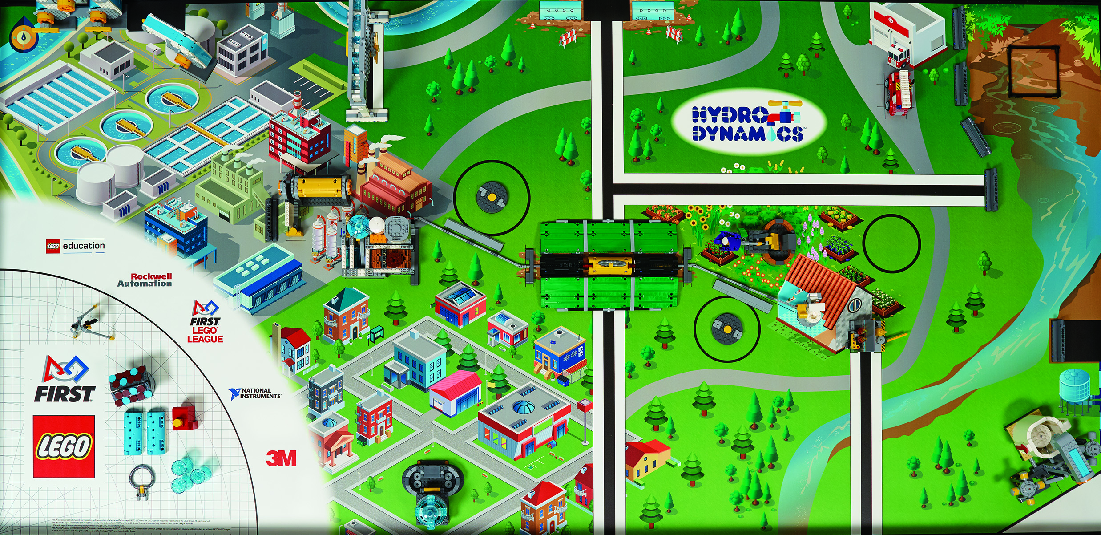
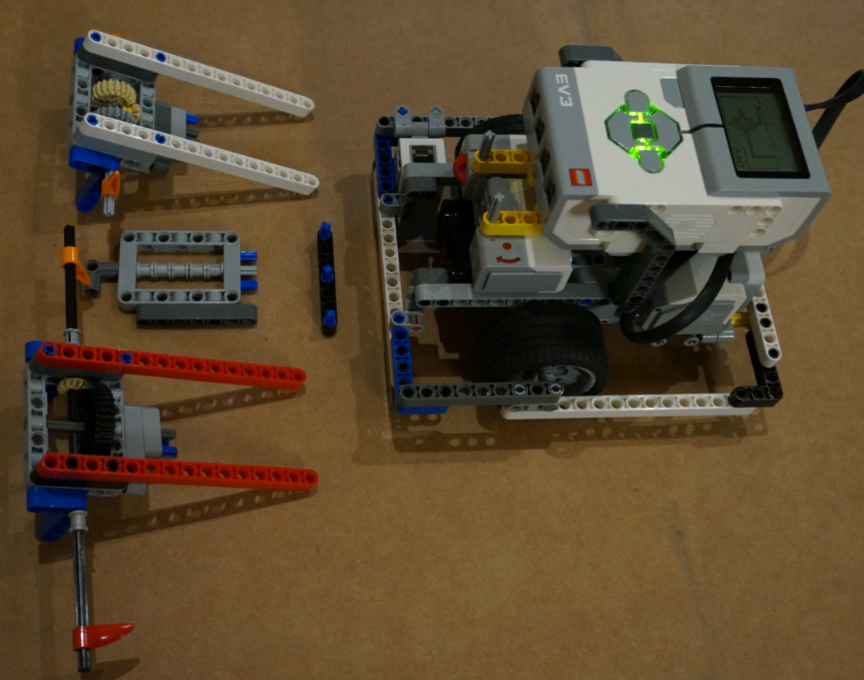
TERMS TO KNOW
A mission is one of the approx.15 tasks that the robot must complete on the FIRST LEGO League table.
A Run (sortie) is every time the robot leaves the base area. During this run, the robot may complete one or more missions.
A base robot is just the main MINDSTORMS robot chassis. The attachments are other mechanisms added to the base robot to complete a mission (e.g. an arm)

Slide 25
PICKING MISSIONS
Each mission has different points, is in a different location, and often is activated differently.
Time Limit: 2 mins 30 seconds
Do the greatest number of missions/points you can in this time
Beginner Team:
Try to group missions (by area). These might be doable together (in one run)
Missions closer to base first
Once those missions are reliable, work your way out
Intermediate Team
Do missions further away on the game board
Combine more missions together
See if one attachment might be able to accomplish more than one mission

Slide 26
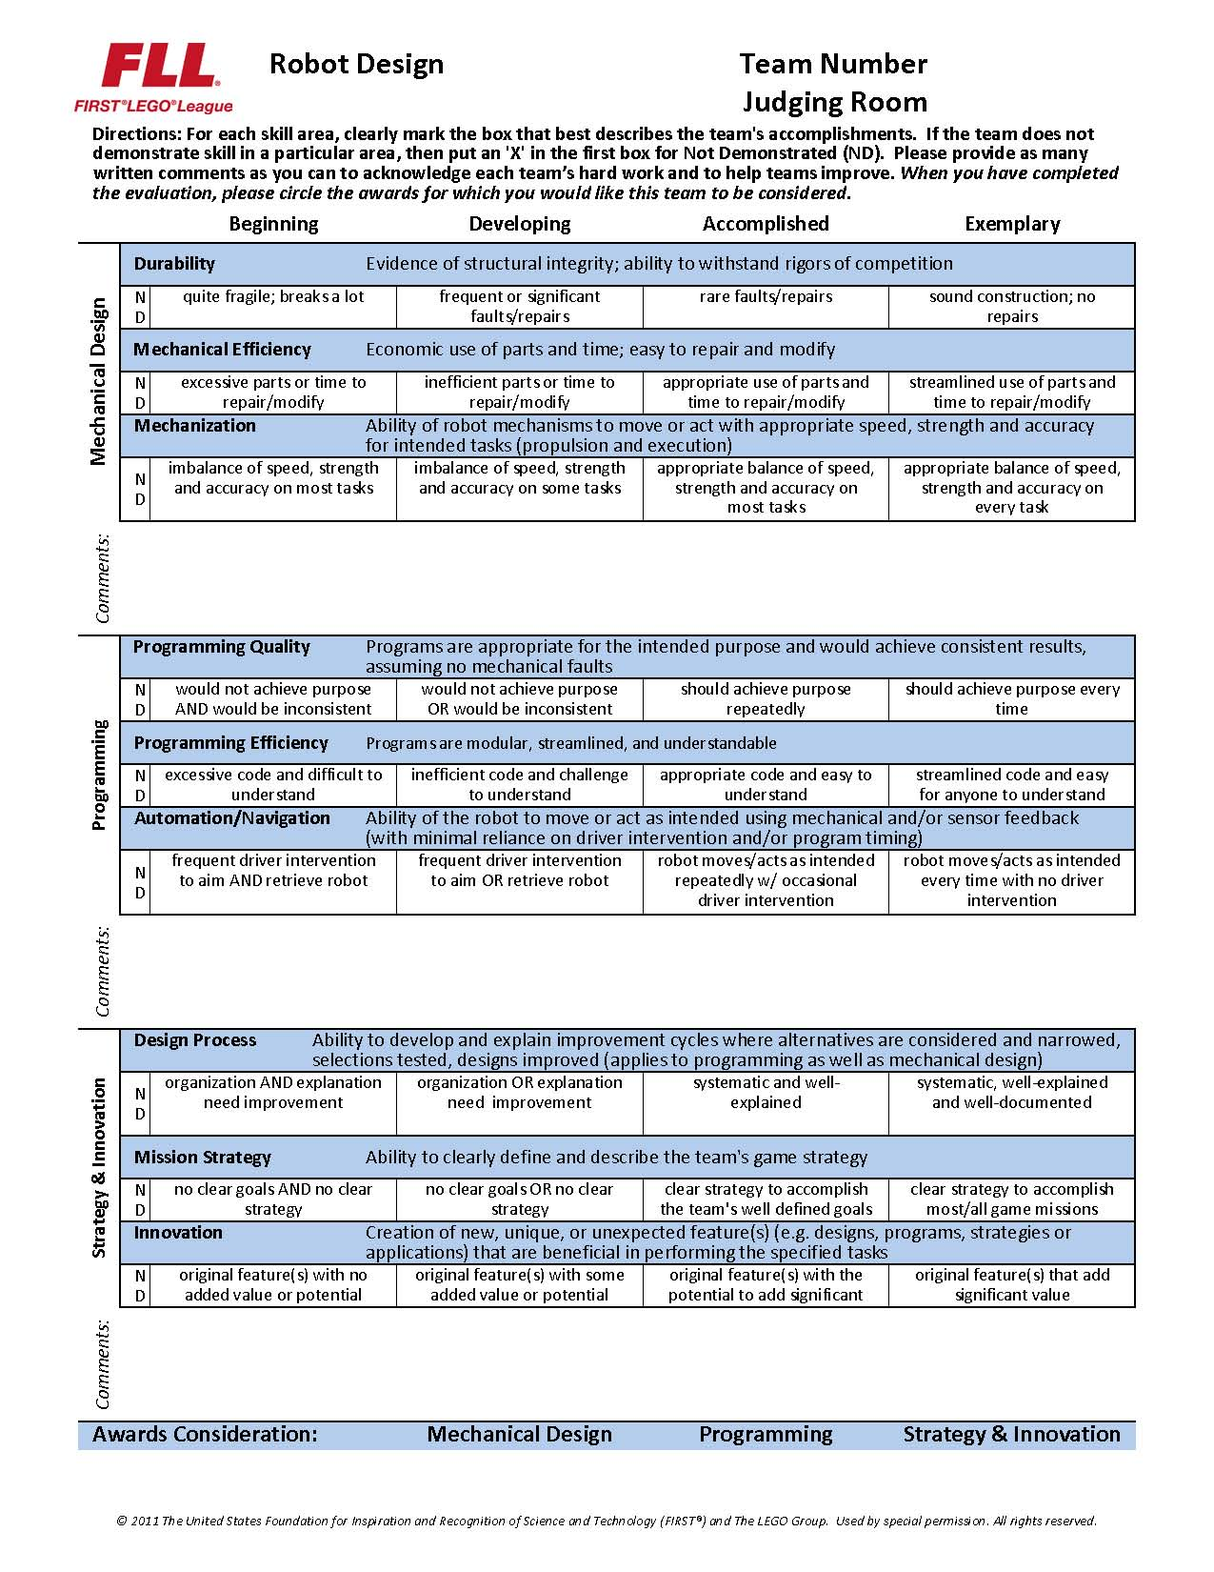
ROBOT DESIGN RUBRIC
Mechanical Design:
Durable, efficient, and capable of executing tasks
Programming:
Clear and concise code that allows the robot to be autonomous and consistent
Strategy & Innovation
Clever robot designs and programming and well developed strategy

Slide 27
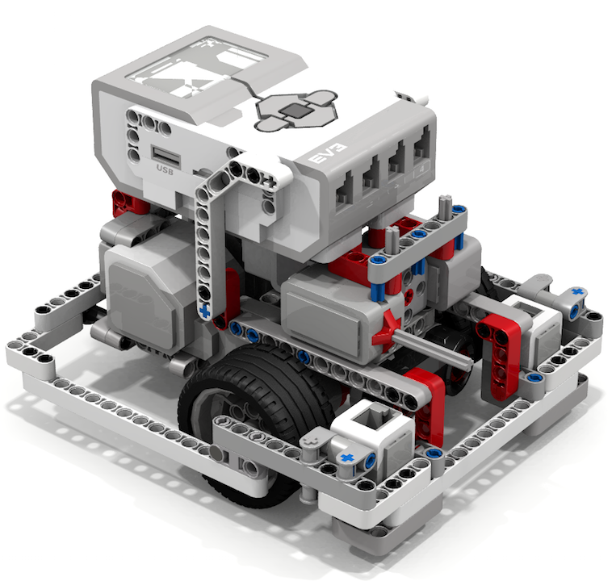
ROBOT DESIGN TIPS
Sturdy, well-balanced
DroidBot is recommended by FIRST Steps (curriculum written by FIRST)
Link for FIRST Steps http://info.firstinspires.org/fllfirststepsrequest
Can download design from EV3Lessons
Consider adding these features basic to your robot
Access to charging port and USB port
2 color sensors to align
Compact
Outer wall to align and keep wheels in place

Slide 28
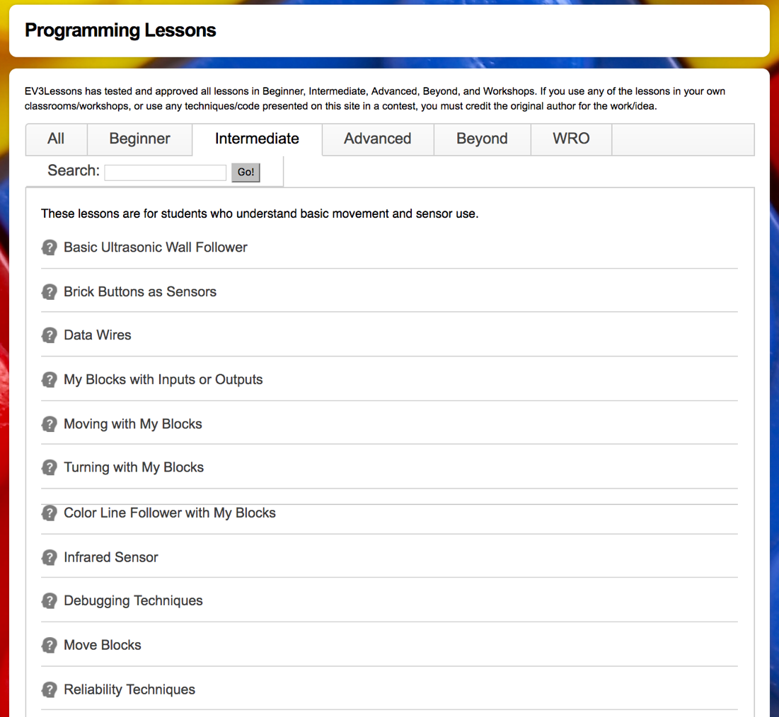
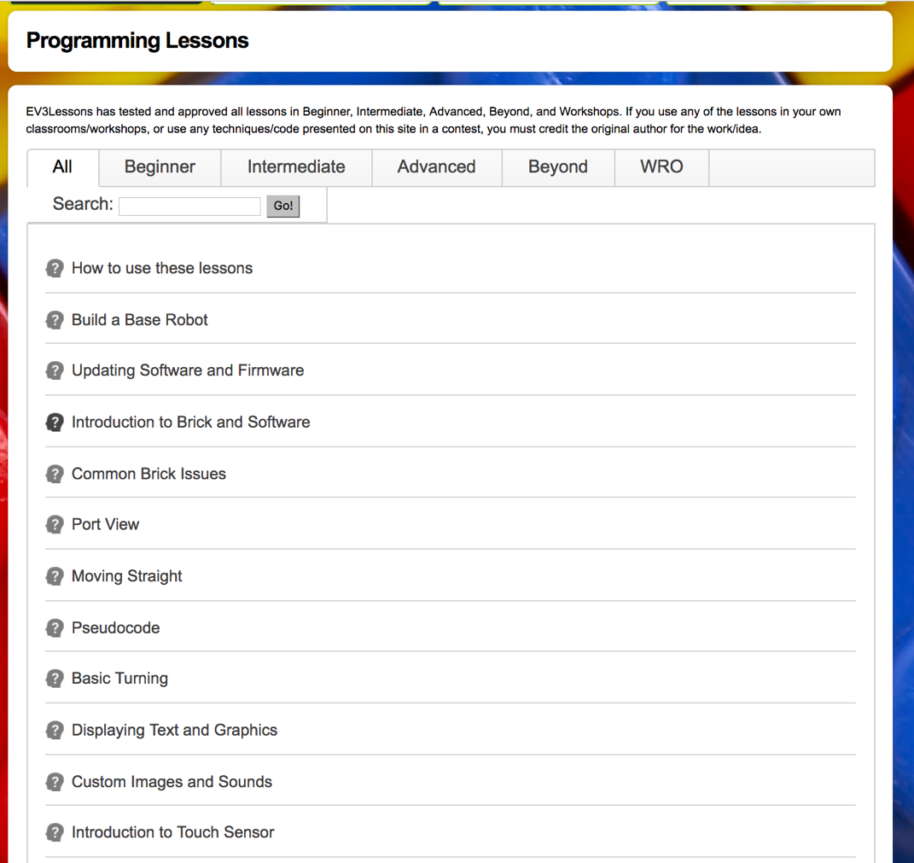
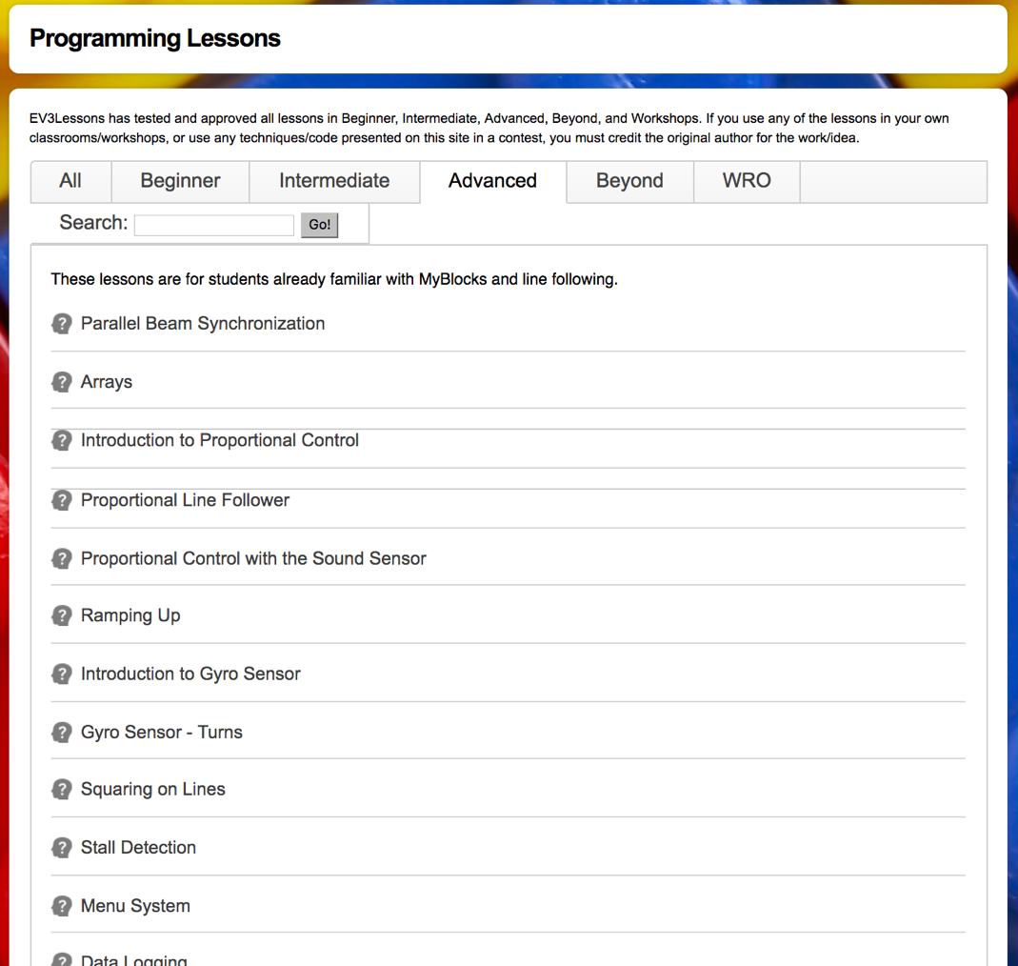
LEARNING TO PROGRAM: EV3LESSONS.com

Slide 29
RECOMMENDED PROGRAMMING CONCEPTS TO LEARN
Beginner Team
Move Until a Color (a line on the mat)
Move Until Touch (wall or mission model)
Move Until Ultrasonic (a mission model)
Loops and Switches
Comments in code
Basic Line Follower
Intermediate Team
Using My Blocks (reusable code blocks)
Align on a Line/Squaring on a Line (increasing reliability)
Parallel Beams
Intermediate-level Line Follower (3-state, proportional)

Slide 30
Reliability

Slide 31
HOW CAN YOU INCREASE RELIABILITY?
Consistent aligning in base
Frequent aligning during a run

Slide 32
Starting Points in Base are Critical
Mission
In FIRST LEGO League, teams need to figure out where to start in base
Jigs: a LEGO ruler/wall that your robot can align against them in base
Same start each time: pick one spot and start there no matter what the mission for easy starts
Marks/Radial lines: Use the marks to pick a starting spot for each run
Words: Base has words. If you aren’t near an inch mark, pick a word or letter to start on.
Use a jig
Use marks

Slide 33
Errors Accumulate Over Time
By the time you get to the far side of the table, you are no longer in the right position
Solution: Repeat alignment techniques multiple times in a run for better reliability (see next slide)
Mission Model 1
Mission Model 2

Slide 34
Where Are You on the FLL table?
Consider these alignment strategies that are commonly used:
Move until a sensor reading– E.g., travel until you find a line so you know where you are on the mat (See Beginner: Color, Ultrasonic and Touch Sensors)
Align on walls/mission models – deliberately back into a wall/model to straighten out (note: You may stall doing this – Tip: use move seconds or a touch sensor)
Square/Align on lines –If you are moving angled, you can straighten out whenever you see a line. (See Advanced: Squaring Lesson)
Back into walls
Square on a line
Align on a mission model
Mission Model

Slide 35
PROGRAMMING: WHY USE SENSORS
Using sensors in FIRST LEGO League is very important (even in your rookie year)
Sensors improve reliability
Sensors can help you know where you are during a run

Slide 36
Move Until

Slide 37
MOVE UNTIL
Move Until is very valuable in FLL:
A black line (color)
A mission model (touch)
A distance (ultrasonic)

Slide 38
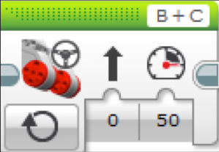
Making The Robot Move
What would happen if you placed a Move Steering Block and left the motor “On”?
Would the robot…
1) Move?
2) Move for a little while?
3) Not move at all?
ANS. Not move at all.
What does Motor Off do?
Rookie Tip: Motor On needs to be followed by another block (e.g. Wait Block)

Slide 39
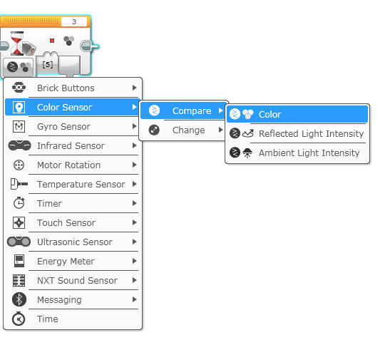
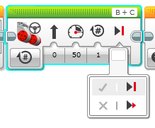
COLOR SENSOR CHALLENGE
Make the robot move up to a black using the color sensor
Step 1: Use Wait For Color
Step 2: Use the color sensor in COLOR MODE
Step 3: Coast or Brake?
Hint: You will use Move Steering (think about motor on and off) and Wait for “Color”

Slide 40
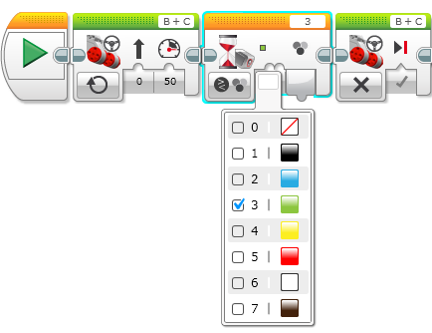
Color Sensor Challenge Solution
FINISH
Move Steering
Set to “ON”
Move Steering
Set to “OFF” with BRAKE
START
Wait until Color is Black (#1)

Slide 41
Loops

Slide 42
Repeating an Action
Let’s say we want the robot to repeat an action over and over again.
Would you just copy the block multiple times?
Sure, that could work!
What if I want to repeat that block forever?
Now what?

Slide 43

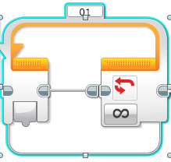
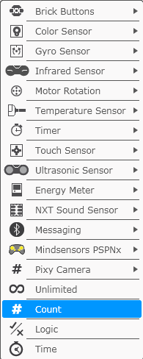
Loops
Loops make repeating a task multiple times easy
The added benefit is that a loop can end whenever you want (a specific number of times, run forever, a specific condition, etc)

Slide 44
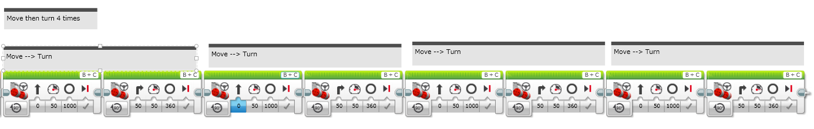
LOOP CHALLENGE
Challenge: Write a program to go around a box once.
The simple way is to code it like this:
Use a loop to improve the code

Slide 45
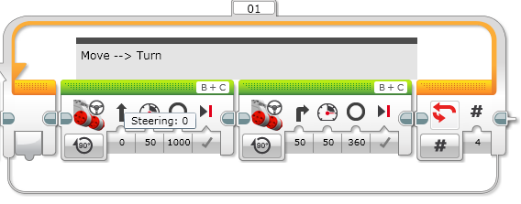
Loop CHALLENGE Solution
Run 4 times

Slide 46
Switches

Slide 47

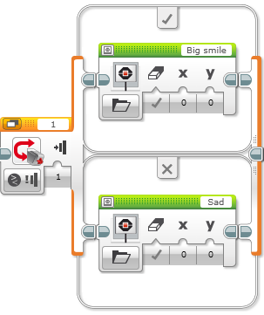
Switch Blocks
Run this code if the answer is yes
Asking the robot a question and doing something different based on the answer
Example: Does the robot see a line? Or not?
Basically a YES/NO QUESTION
Switch blocks are found in the orange/flow tab
The question being asked: is the touch sensor pressed
Run this code if the answer is no

Slide 48

Switch Block CHALLENGE 1
Challenge: Write a program that changes the display based on if the touch sensor is pressed or not pressed.
If pressed, your EV3 is happy! Display a smiley face. If not pressed, the EV3 is sad! Display a sad face.
Hint: You will need to use the display block, loops and switch blocks!

Slide 49
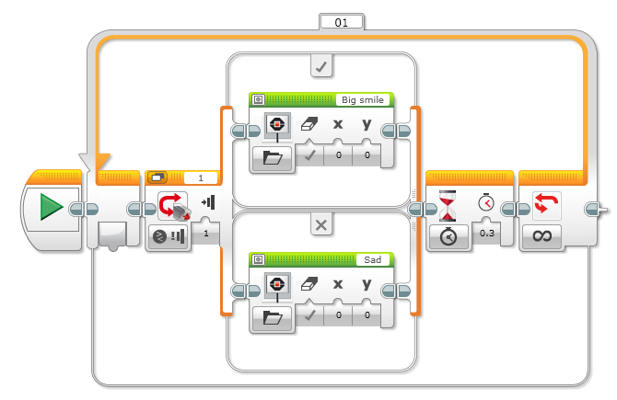
Challenge 1 SOLUTION
Display Block
Touch Sensor
Selected
Wait Block
Loop
Display Block

Slide 50
Switch Block Challenge 2
Can you write a program that display big eyeballs if you touch it once and a sad face if you touch it a second time and toggles back and forth.

Slide 51
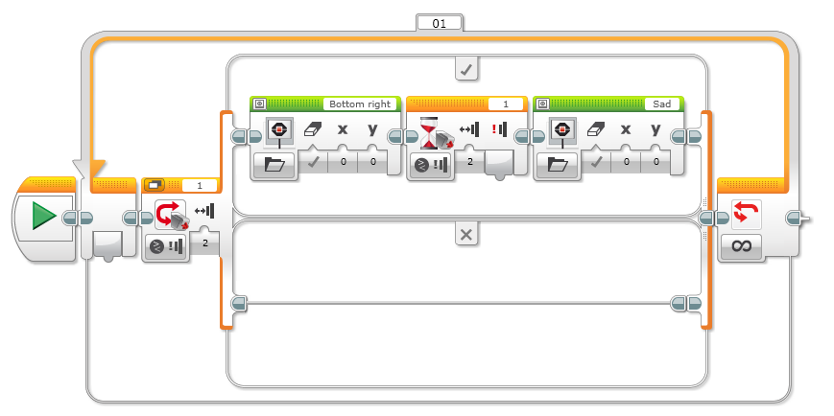
Challenge 2 solution

Slide 52
Basic Line Follower

Slide 53
LESSON OBJECTIVES
Learn how humans and robots follow lines
Learn how to get a robot to follow a line using Color Mode on the EV3 Color Sensor
Learn how to follow a line until a sensor is activated
Learn how to follow a line for a particular distance
Learn how to combine sensors, loops and switches

Slide 54

FOLLOW THE MIDDLE?
Humans want to follow the line in the middle.
Let’s have the robot do the same thing using the Color Sensor
What type of questions can we ask using this sensor
Are you on line or not?

Slide 55
If we are on black, keep going straight
If we are on white, turn left to get back to the line
Seems to work fine here…

Slide 56
If we are on black, keep going straight
If we are on white, turn left to get back to the line
OH NO… my robot is running away….
When the robot leaves the left side of the line, the program no longer works!

Slide 57
Line Following: ROBOT STYLE
Why could the Human follow the middle?:
They can see ahead.
They can see the whole line and its surroundings
They see both sides and which side they left
Why can’t the Robot do the same thing?:
Can’t tell right or left side of the line
How do we make sure the robot always veers off on the SAME SIDE of the line?
Instead of the middle, could the robot follow the “edge”?
So now the robot will fall off only the same side.
We will now show you how this works!

Slide 58
ROBOT LINE FOLLOWING Happens on the edges
Left side line following
Right side line following
If on black, turn left.
If on white turn right.
If on black, turn right.
If on white turn left.
The robot has to choose which way to turn when the color sensor sees a different color.
The answer depends on what side of the line you are following!

Slide 59
starting the roboT on the correct side
✗
✔
✔

Slide 60
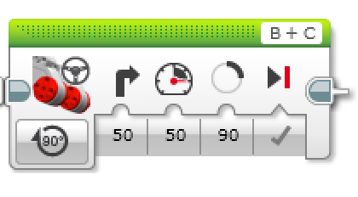
Line Follower challenge 1
Step 1: Write a program that follows the RIGHT edge of a line.
Hints: If your sensor sees black, turn right. If your sensor sees white, turn left. Use loops and switches!
Step 2: Try it out on different lines.
Did your line follower work the same on straight and curved lines?
Step 3: If not, instead of turn Steering = 50, try smaller values.
Is it better on the curved lines now?
B
B
C
C

Slide 61
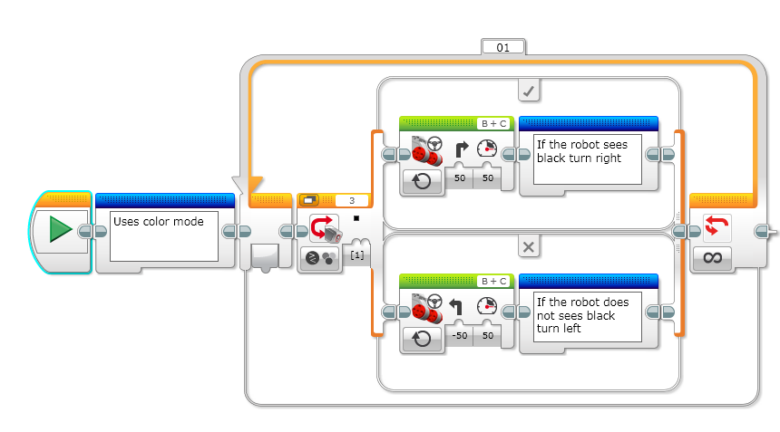
LINE FOLLOWING CHALLENGE SOLUTION
Q. Does this program follow the Right or Left side of a line?
A. The robot is following the Right Side of the line.
Notes:
Right side

Slide 62
CHALLENGE 1 SOLUTION
Q. This line follower goes forever. How do we make this stop?
A. Change the end condition on the loop.
Notes:
Right side

Slide 63
Line follower challenge 2
Part 1: Make a line follower that stops when you press the touch sensor
Part 2: Make a line follower that stops after it travels a particular distance

Slide 64
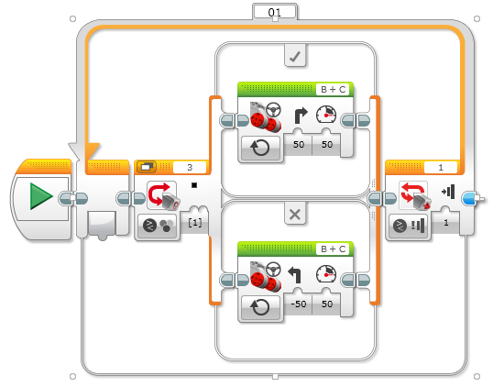
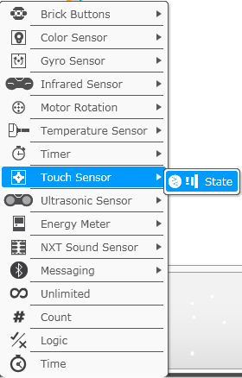
Challenge 2 SOLUTION: SEnsor

Slide 65
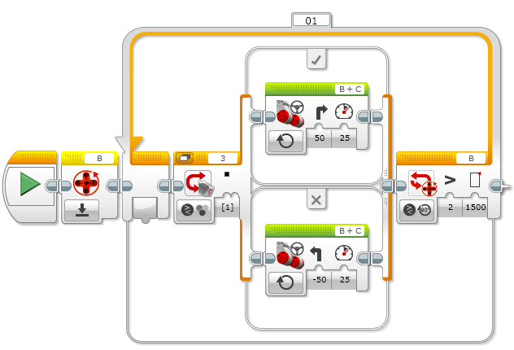
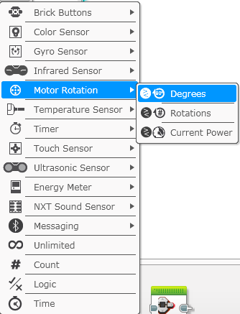
Challenge 2 SOLUTION: PARTICULAR distance

Slide 66
USEFUL LINKS
EV3Lessons
Programming Lessons
Coach’s Corner - Tips from coaches around the world
Team Building Activities
Scoring Tool for Hydro Dynamics - http://ev3lessons.com/resources/scorer/index.html
Sketch Planner - http://ev3lessons.com/resources/drawplan
FIRST Steps:
http://info.firstinspires.org/fllfirststepsrequest
Hydro Dynamics Challenge Documents (including build instructions, field setup, and rubrics):
http://www.firstlegoleague.org/challenge
State-Specific Information
How to register
Forums
Senior Mentor
Customize this slide

Slide 67
CREDITS
This presentation was created and complied by Sanjay and Arvind Seshan (EV3Lessons).
Thank you to Ibot Braniacs for collaborating on an earlier draft of this presentation.
You are free to use and modify this presentation for your own workshops. We have indicated slides that need to be customized for your region/state
The programming lessons are available on EV3Lessons.com
All photographs were taken by EV3Lessons/Not the Droids You Are Looking for unless indicated and may be freely used with credit if needed.

